Slide 1


NALAIYA THIRAN - Project Work
M.A.M. COLLEGE OF ENGINEERING AND TECHNOLOGY
Siruganur, Tiruchirappalli – 621 105.
Project Title:IOT Based safety gadgets for child safety monitoring and notification
Register Number | Name of student
812019205027 | M.Priyadharshini
812019205029 | R.Ragavi
812019205050 | K.Swetha
812019205056 | S.Vijayalakshmi
Under the esteemed guidance of
Mentor Name & Designation: Fathima Chandini ASP/IT
Evaluator Name & Designation: Dr. K .Geetha Prof & Head / IT
Version: MAMCET_PR-1.1
Notes:
Notes for Teachers:
The Synopsis presentation should contain 1. Real life applications 2. Overview of the subject 3. PO’s CO’s of the course 4. Individual Units overview 5. Lesson Plan 6. Flip Class topics
“ Be professionally dressed and use a QUALITY PEN. Never hand an ordinary PEN as a Cosmetic Effect”

Slide 2
Problem Definition
This paper provides an Android based solution for the parents to track their children in real time. Different devices are connected with a single device through channels of internet.The concerned device is connected to server via internet. The device can be used by parents to track their children in real time or for women safety. The proposed solution takes the location
services provided by GSM module. It allows the parents to get their child’s current-location via SMS.
Merits: A child tracking system using android terminal and
hoc networks.
Demerits: This device cannot be used in rural areas.

Slide 3
Empathise & Discover
What do they think &feel ?
What do they hear?
What do they say & do ?
What do they say ?

Slide 4
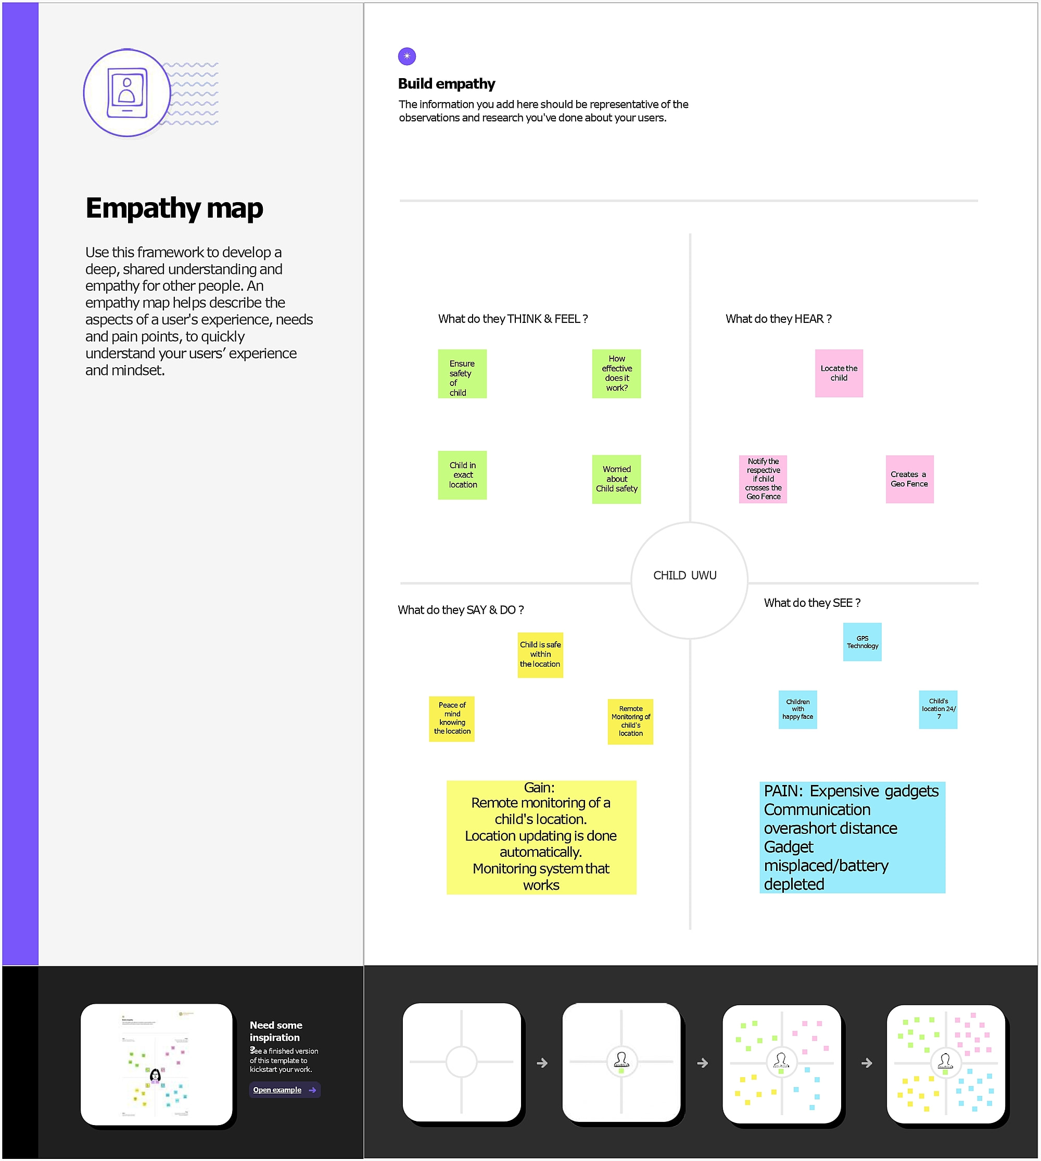

Slide 5
Brainstorming
Write down any ideas that come to mind for child safety monitoring system.
Take turns sharing your ideas while clustering similar or related notes as you go. Once all sticky notes have been grouped, give each cluster a sentence-like label. If a cluster is bigger than six sticky notes, try and see if you and break it up into smaller sub-growing.
Your team should all be on the same page about what's important moving forward. Place your ideas on this grid to determine which ideas are important and which are feasible
You can export the mural as an image or pdf to share with members of your company who might find it helpful

Slide 6
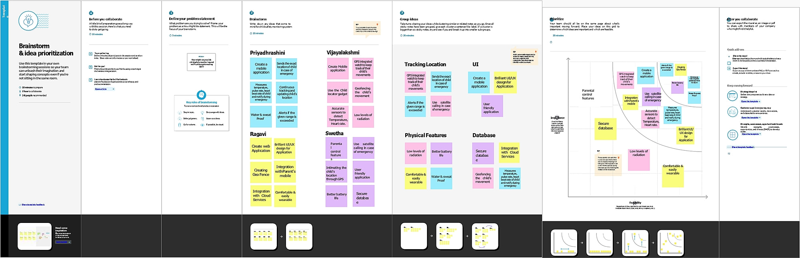

Slide 7
Proposed solution
Different components such as temperature sensor, heartbeat sensor, panic button, contact switch are connected to the link it ONE board along with built in GSM, GPS modules. Safety gadget consists of BEACON and BLE packet is transmitted through it, this packet is received by binding gadget which has BLE receiver module, the packet usually contains information such as identification number, signal strength etc. Temperature is one of the most commonly measured variables. For measuring body temperature of the child DS18B20 temperature sensor is used. The heartbeat sensor is used in the proposed system for measuring the pulse rate.

Slide 8
Problem solution fit
CUSTOMER SEGMENT(S)
Our Customers are mainly parents who are working and do not have enough time to take care of their children.
JOBS-TO-BE_x0002_DONE/PROBLEMS
To ensure the parents that their surveillance on their children can never be taken off
TRIGGERS
The trigger which induces the customers is the one that when other working parents give a try to this and comment a positive review on this, they also erdtoday center their childsafety.

Slide 9
AVAILABLE SOLUTIONS
Of course the solutions are available readily in the market such as angel monitoring system, Child GPS Tracking System, Child Safety GSM Kit, etc....
CUSTOMER CONSTRAINTS
The constraints our customers facing are such connectivity issues or may be the protocols being used for communication.
BEHAVIOUR
Our proposed solution has the modes of working in both offline and Online.
CHANNELS of BEHAVIOUR
In case of any disconnectivities happen the gadget which has been developed might tend to work on a plan B ehich includes the backup of the failure of actual working kit.
PROBLEM ROOT CAUSE
Considering the origination of the problem, it occurs in the base of merely irrespective
persons that are no way relatable to the children but for the currency kind of thing and
also the child abuse(mainly in case of girl children)

Slide 10
Solution Architecture
Solution architecture is a complex process – with many sub-processes – that bridgesthe gap between
business problems and technology solutions. Its goals are to:
• Find the best tech solution to solve existing business problems.
• Describe the structure, characteristics, behavior, and other aspects of thesoftware to
project stakeholders.
• Define features, development phases, and solution requirements.
• Provide specifications according to which the solution is defined, managed,
and delivered. Solution.

Slide 11
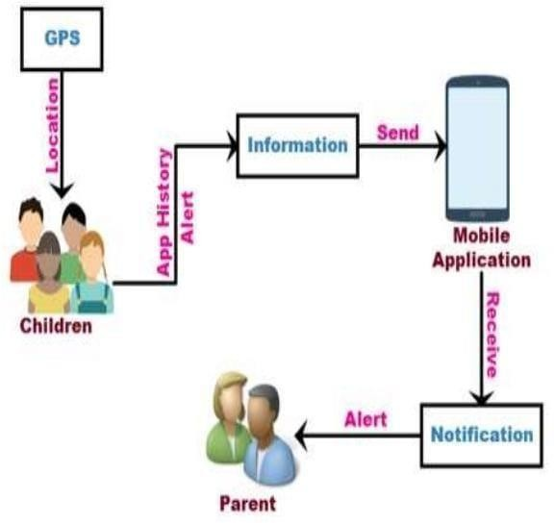

Slide 12
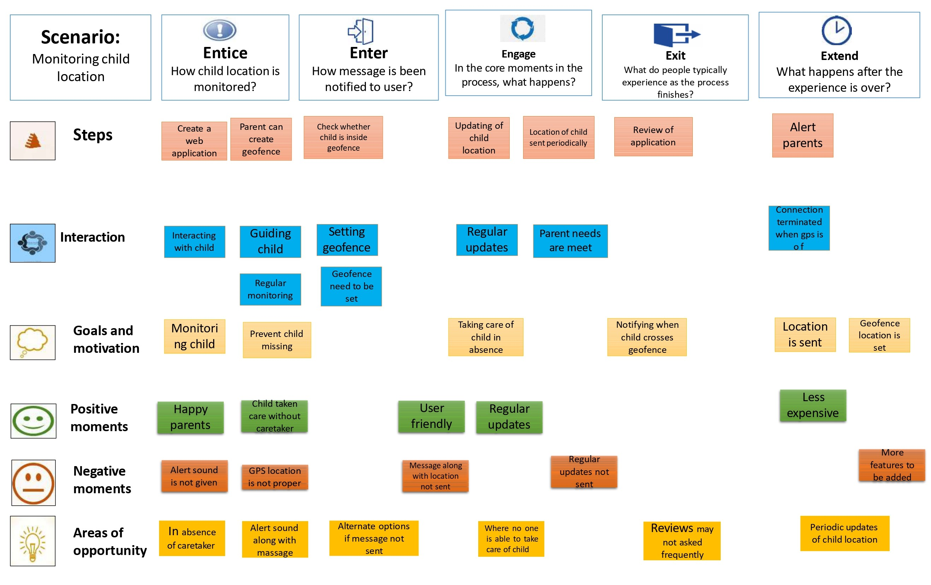
Customer Journey Map

Slide 13
Functional & Operational Requirements
FR No. | Functional Requirement (Epic) | Sub Requirement (Story / Sub-Task)
FR-1 | User Registration | Registration through Form Registration through Gmail
FR-2 | User Confirmation | Confirmation via Email Confirmation via OTP
FR-3 | Notification | Notified via Mobile App
FR-4 | User Interface | Mobile App- MIT App Inventor Able to see location of children when they are out of geofence

Slide 14
Technical Architecture
User Interface
The communication protocol being used in the proposed solution might act as an interface the way like WiFi, Bluetooth and ZigBee, MIT app technology.
Application Logic
The data to be collected and sent to the authenticator’s(parent) via GSM providing the GPS coordinates to
easily locate access and monitor the child, IBM Watson STT service, python etc technologies.
Database
Data to be segregated and secured in the form of relational DBMS, MySQL technology.
Cloud Database
IBM Cloudant technology.
File Storage
File storage requirements, IBM Block Storage or Other Storage Service or Local Filesystem.

Slide 15
Open source Framework Used
Open Source Framework
Nodered
Node-RED is a programming tool for wiring together hardware devices, APIs and online services in new and interesting ways. It provides a browser-based editor that makes it easy to wire together flows using the wide range of nodes in the palette that can be deployed to its runtime in a single-click.

Slide 16
Third Party API
REST API monitor regularly checks the availability and response of your REST API endpoints over IPv4 or IPv6 enabled locations and alerts you if the API response values does not validate against the specified RegEx/XPath/JSONPath assertions. Additionally, test and validate your JSON response against the JSON schema specified by you. To bulk import REST API endpoints, simply upload your predefined HAR/Swagger (JSON)/ CSV file into Site24x7.
NodeMCU is a low-cost open source IoT platform. It initially included firmware which runs on the ESP8266 Wi-Fi SoC from Espressif Systems, and hardware which was based on the ESP-12 module. Later, support for the ESP32 32-bit MCU was added.

Slide 17
Cloud Deployment
cloud computing in combination with the Internet of Things will make fundamental changes to the life of mankind, particularly in how information is managed. The cloud is the only technology that can analyze, store, and access the IoT depending on the deployment model. Because of the nature of on-demand information, cloud computing with an Internet connection is available on any device at any time. As hybrid cloud adoption grows, many companies are realizing its benefits and the need to implement it. Cloud computing will continue to open up new opportunities for the IoT for a long time to come.

Slide 18
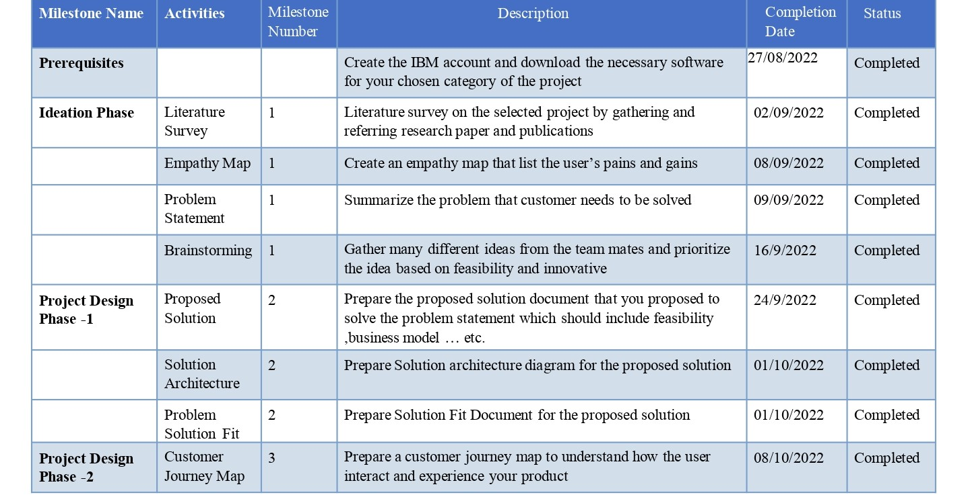
Project Milestone & Task

Slide 19
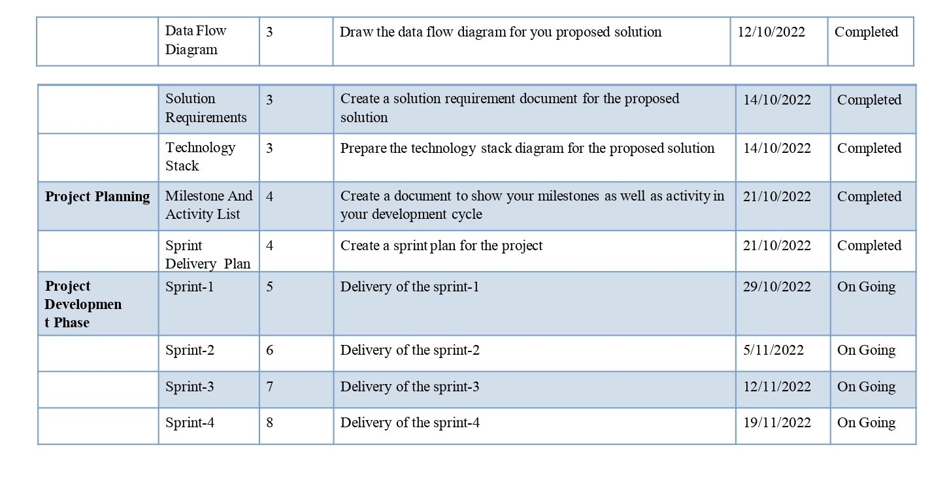

Slide 20
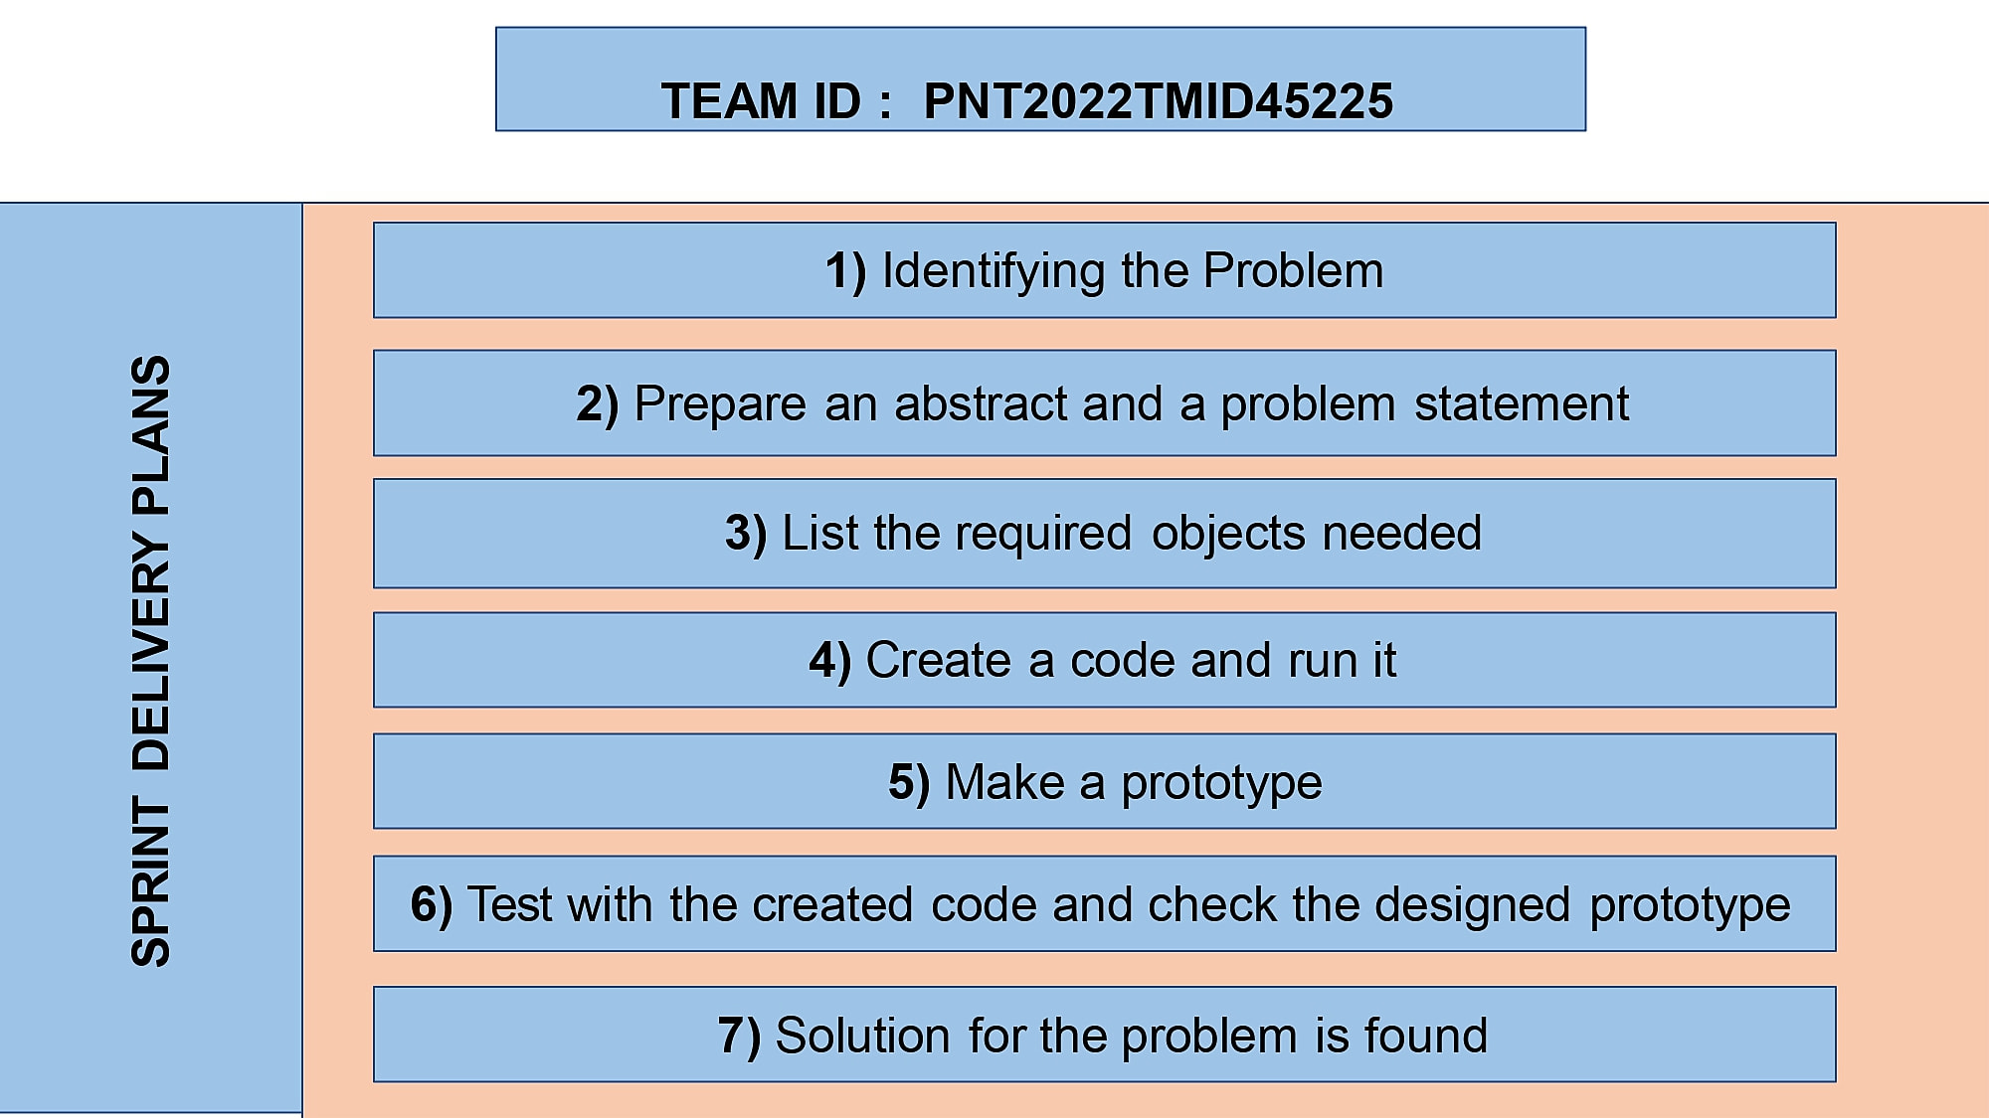
Sprint Delivery Plan

Slide 21
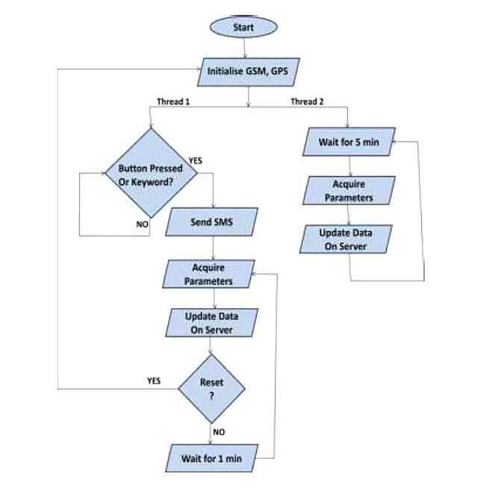
Project Progress Tracking

Slide 22
Project Planning Tool
• Arduino Mega [ATMEGA 2560].
• GSM SIM 800C.
• GPS Neo 6m.
• 20X4 LCD.
• 7805 Voltage Regulator.
• Heart Beat Sensor.
• DS18B20 Temperature Sensor.
• 1x4 Switch.
• ESP8266-12E
• Jumper Cables
Software Requirements:
• Arduino IDE
• Android Studio
Languages Used:
• Embedded C
• Java

Slide 23
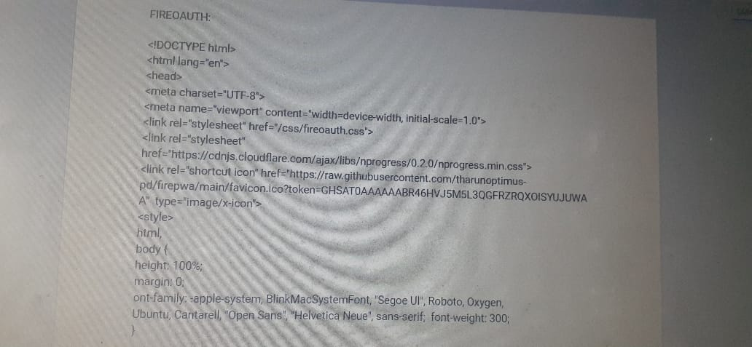
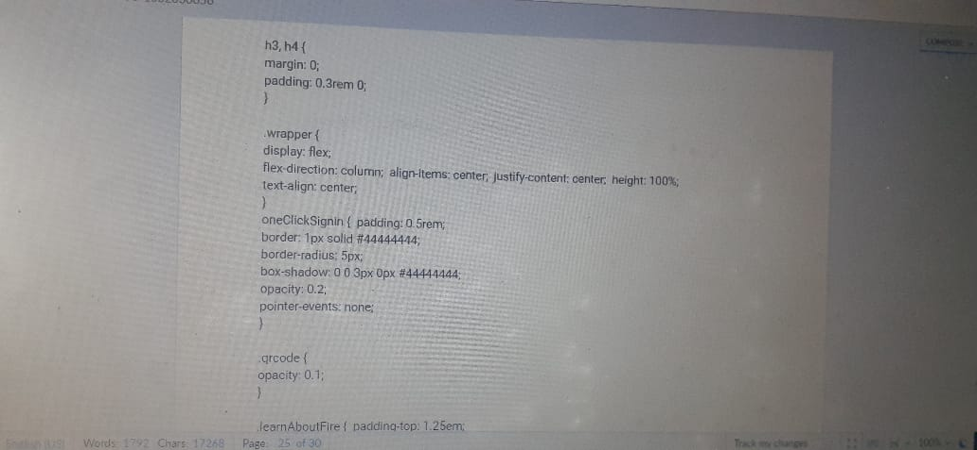
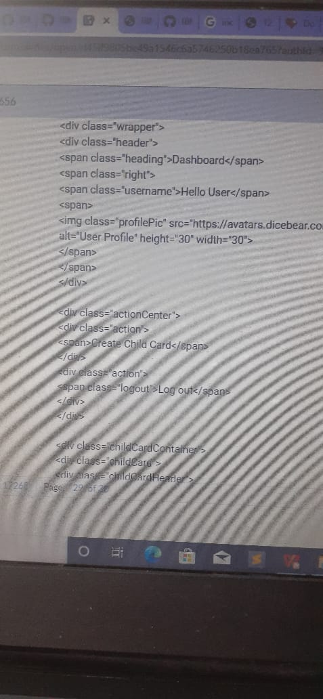
Coding & Solutioning

Slide 24
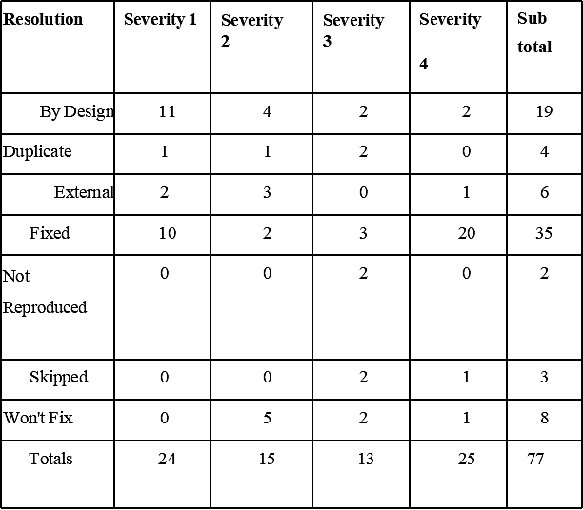
Acceptance Testing
1 .Defect Analysis

Slide 25
Performance Metrics
1) Live Location Tracking
2) Panic Alert System
3) Stay Connected Feature
4) Health Monitoring System
5) Gadget Plug and Unplug Monitoring
6) Boundary Monitoring System

Slide 26
Project Demonstration
Drive link of the Project Demonstration has to be included
https://workdrive.zohoexternal.com/writer/open/rl45if9805be49a1546c6a5746250b18ea765?authId=%7B%22linkId%22%3A%225k2wApabNRZ-LYmlU%22%7D

Slide 27
Project Documentation
Drive link of the Project Documentation has to be included
https://workdrive.zohoexternal.com/writer/open/rl45if9805be49a1546c6a5746250b18ea765?authId=%7B%22linkId%22%3A%225k2wApabNRZ-LYmlU%22%7D

Slide 28
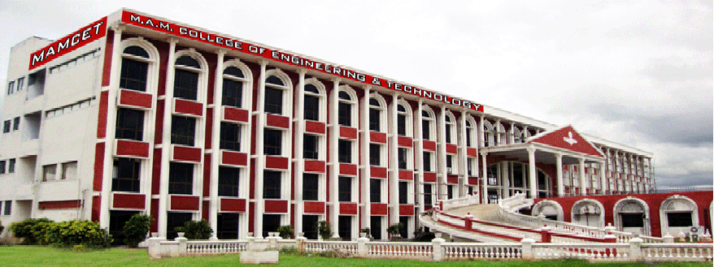
Thank You Slide

